Slide 1
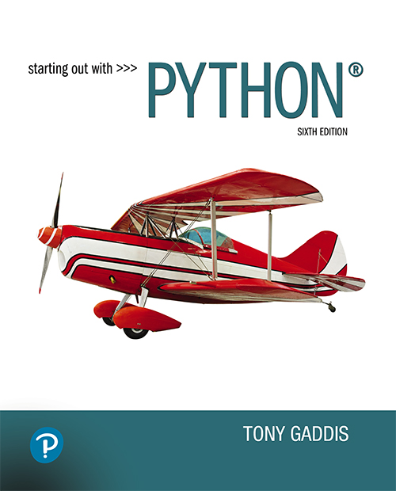

Starting Out with Python
Sixth Edition
Chapter 7
Lists and Tuples
Copyright © 2023, 2021, 2018 Pearson Education, Inc. All Rights Reserved
Notes:
If this PowerPoint presentation contains mathematical equations, you may need to check that your computer has the following installed:
1) MathType Plugin
2) Math Player (free versions available)
3) NVDA Reader (free versions available)

Slide 2
Topics (1 of 2)
Sequences
Introduction to Lists
List Slicing
Finding Items in Lists with the in Operator
List Methods and Useful Built-in Functions

Slide 3
Topics (2 of 2)
Copying Lists
Processing Lists
List Comprehensions
Two-Dimensional Lists
Tuples
Plotting List Data with the matplotlib Package

Slide 4
Sequences
Sequence: an object that contains multiple items of data
The items are stored in sequence one after another
Python provides different types of sequences, including lists and tuples
The difference between these is that a list is mutable and a tuple is immutable
Immutables can't be changed after creation, mutables can be

Slide 5
Introduction to Lists (1 of 2)
List: an object that contains multiple data items
Element: An item in a list
Format: list = [item1, item2, etc.]
Can hold items of different types
print function can be used to display an entire list
list() function can convert certain types of objects to lists

Slide 6


Introduction to Lists (2 of 2)
Figure 7-1 A list of integers
Figure 7-2 A list of strings
Figure 7-3 A list holding different types

Slide 7
Indexing
Index: a number specifying the position of an element in a list
Enables access to individual element in list
Index of first element in the list is 0, second element
is 1, and n’th element is

Slide 8
The len function
An IndexError exception is raised if an invalid index is used
len function: returns the length of a sequence such as a list
Example: size = len(my_list)
Returns the number of elements in the list,
so the index of the last element in a list is len(my_list)-1
Can be used to prevent an IndexError exception when iterating over a list with a loop

Slide 9
Lists Are Mutable
Mutable sequence: the items in the sequence can be changed
Lists are mutable, and so their elements can be changed
An expression such as
list[1] = new_value can be used to assign a new value to a list element
Must use a valid index to prevent raising of an IndexError exception

Slide 10
Concatenating Lists
Concatenate: join two things together
The + operator can be used to concatenate two lists
Cannot concatenate a list with another data type, such as a number
The += augmented assignment operator can also be used to concatenate lists

Slide 11
Methods vs Functions
Methods = Object’s own actions Functions = General-purpose helpers
Method format: <object_name>.<method_name>( )
Ex: mylist.append( "dog" )
Function format: <function_name>(<object_name>)
Ex: list_len = len( mylist )

Slide 12
List Methods Format: <list_name>.<method_name>()
append(item): used to add items to a list – item is appended to the end of the existing list
count(item): returns the number of times item appears in the list
index(item): used to determine where an item is located in a list
Returns the index of the first element in the list containing item
Raises ValueError exception if item not in the list

Slide 13
List Methods Format: <list_name>.<method_name>()
insert(index, item): used to insert item at position index in the list
sort(): used to sort the elements of the list in ascending order
remove(item): removes the first occurrence of item in the list
pop(index): removes the element at the index provided
reverse(): reverses the order of the elements in the list

Slide 14
Built in Functions
sum function: returns the sum of the values in a numeric sequence
Example: total = sum(my_list)
min and max functions: built-in functions that returns the item that has the lowest or highest value in a sequence
The sequence is passed as an argument

Slide 15
Finding Items in Lists With the in Operator
You can use the in operator to determine whether an item is contained in a list
General format: item in list
Returns True if the item is in the list, or False if it is not in the list
Similarly you can use the not in operator to determine whether an item is not in a list

Slide 16
Tuples (1 of 4)
Tuple: an immutable sequence
Similar to a list
Tuples are immutable. Once a tuple is created:
New elements cannot be added to the tuple
Elements cannot be removed from the tuple
The values stored in tuple elements cannot be changed

Slide 17
Tuples (2 of 4)
Creating a Tuple
my_tuple= (item1, item2)
my_tuple= (item1,)
Tuples support many list operations
Subscript indexing for retrieving elements
Methods such as index
Built in functions such as len, min, max
The in, +, and * operators

Slide 18
Tuples (3 of 4)
Tuples do not support the methods:
append
remove
insert
reverse
sort

Slide 19
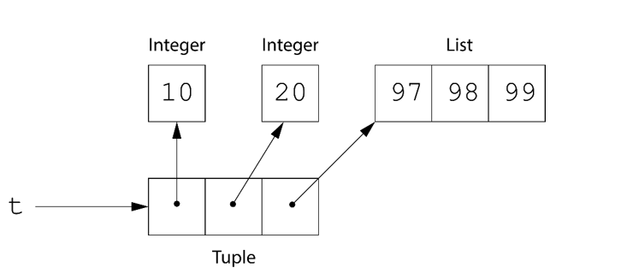
Storing Mutable Objects in a Tuple (1 of 2)
Although tuples are immutable, you can store mutable objects in a tuple.
For example, the following statement creates a tuple that contains a list as its 3rd element:
t = (10, 20, [97, 98, 99])
Notes:
A code statement reads, t = left parenthesis 1 comma 20 comma left bracket 97 comma 98 comma 99 right bracket right parenthesis. A diagram illustrates the process of storing mutable objects in a tuple. t references a tuple, which has three parts. The first part stores integer value 10. The second part stores integer value 20. The third part stores a list with integer values, from left to right, 97, 98, 99.

Slide 20
Storing Mutable Objects in a Tuple (2 of 2)
When a tuple element refers to a mutable object, that object's data can be changed.
>>> t = (10, 20, [97, 98, 99])
>>> print(t)
(10, 20, [97, 98, 99])
>>>
>>> t[2].append(100)
>>> print(t)
(10, 20, [97, 98, 99, 100])
>>>

Slide 21
Tuples (4 of 4)
Reasons for using tuples:
Processing tuples is faster than processing lists
Tuples provide safety:
no elements can be added to or deleted from a tuple
once a tuple is created, the elements of the tuple will always refer to the same objects
Some operations in Python require use of tuples
list() function: converts tuple to list
tuple() function: converts list to tuple

Slide 22
Pass By Object Reference
Mutable objects (like lists)
Functional Meaning: if your function changes the object (append, remove, update), the caller’s copy changes too. You don’t need to return it—those edits stick.
Immutable objects (ints, floats, strings, tuples)
Functional Meaning: You can’t change the original in place. If you “modify” it (like x += 1 or s = "a"), you’re making a new object inside the function. The caller’s value stays the same unless you return the new one and assign it

Slide 23
Pass By Object Reference
Watch out:
Rebinding a parameter (a = []) doesn’t affect the caller;
mutating it does affect the caller:
Operations such as those below all update the object and therefore does affect the original
a[0] = 5
a.append(6)
aremove(5)

Slide 24
Copying Lists (1 of 2)
To make a copy of a list you must copy each element of the list into another list
Two methods to do this:
Creating a new empty list and using a for loop to add a copy of each element from the original list to the new list
Creating a new empty list and concatenating the old list to the new empty list

Slide 25
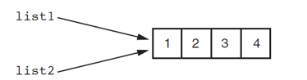
Copying Lists (2 of 2)
Figure 7-4 list1 and list2 reference the same list
list1 = [1,2,3,4]
list2 = list1
# These variables, list1 and list2, reference the same list! Meaning, changes to one list will result in changes to the other!

Slide 26
Processing Lists (1 of 2)
List elements can be used in calculations
To calculate total of numeric values in a list use loop with accumulator variable
To average numeric values in a list:
Calculate total of the values
Divide total of the values by len(list)
List can be passed as an argument to a function

Slide 27
Iterating Over a List
You can iterate over a list using a for loop
Format: for x in list:
You can iterate over a list using a while loop
Format:
l_index = 0
while (l_index < len(list)):
# do something with list
l_index += 1

Slide 28
Processing Lists (2 of 2)
A function can return a reference to a list
To save the contents of a list to a file:
Use the file object’s writelines method
Does not automatically write \n at then end of each item
Use a for loop to write each element and \n
To read data from a file use the file object’s readlines method

Slide 29
The Repetition Operator
Repetition operator: makes multiple copies of a list and joins them together
The * symbol is a repetition operator when applied to a sequence and an integer
Sequence is left operand, number is right
General format: list * n

Slide 30
List Comprehensions (1 of 7)
List comprehension: a concise expression that creates a new list by iterating over the elements of an existing list.

Slide 31
List Comprehensions (2 of 7)
The following code uses a for loop to make a copy of a list:
list1 = [1, 2, 3, 4]
list2 = []
for item in list1:
list2.append(item)
The following code uses a list comprehension to make a copy of a list:
list1 = [1, 2, 3, 4]
list2 = [item for item in list1]

Slide 32

List Comprehensions (3 of 7)
The iteration expression works like a for loop
In this example, it iterates over the elements of list1
Each time it iterates, the target variable item is assigned the value of an element.
At the end of each iteration, the value of the result expression is appended to the new list.

Slide 33
List Comprehensions (4 of 7)
list1 = [1, 2, 3, 4]
list2 = [item**2 for item in list1]
After this code executes, list2 will contain the values [1, 4, 9, 16]

Slide 34
List Comprehensions (5 of 7)
str_list = ['Winken', 'Blinken', 'Nod']
len_list = [len(s) for s in str_list]
After this code executes, len_list will contain the values [6, 7, 3]

Slide 35
List Comprehensions (6 of 7)
You can use an if clause in a list comprehension to select only certain elements when processing a list
list1 = [1, 12, 2, 20, 3, 15, 4]
list2 = []
for n in list1:
if n < 10:
list2.append(n)
Works the same as…
list1 = [1, 12, 2, 20, 3, 15, 4]
list2 = [item for item in list1 if item < 10]

Slide 36
List Comprehensions (7 of 7)
list1 = [1, 12, 2, 20, 3, 15, 4]
list2 = [item for item in list1 if item < 10]
After this code executes, list2 will contain [1, 2, 3, 4]

Slide 37
Two-Dimensional Lists (1 of 3)
Two-dimensional list: a list that contains other lists as its elements
Also known as nested list
Common to think of two-dimensional lists as having rows and columns
Useful for working with multiple sets of data
To process data in a two-dimensional list need to use two indexes
Typically use nested loops to process

Slide 38
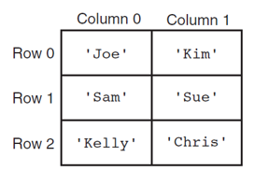
Two-Dimensional Lists (2 of 3)
Figure 7-5 A two-dimensional list
Notes:
The columns have the following headings from left to right. Row headings, Column 0, Column 1, . The row entries are as follows. Row 1. Row 0, Open quote Joe close quote, Open quote Kim close quote. Row 2. Row 1, Open quote Sam close quote, Open quote Sue close quote. Row 3. Row 2, Open quote Kelly close quote, Open quote Chris close quote. Note. The column and row headings are not a part of the list.

Slide 39
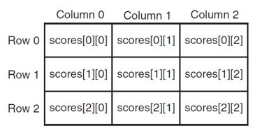
Two-Dimensional Lists (3 of 3)
Figure 7-7 Subscripts for each element of the scores list
Notes:
The columns have the following headings from left to right. Row headings, Column 0, Column 1, Column 2. The row entries are as follows. Row 1. Row 0, scores left bracket 0 right bracket left bracket 0 right bracket, scores left bracket 0 right bracket left bracket 1 right bracket, scores left bracket 0 right bracket left bracket 2 right bracket. Row 2. Row 1, scores left bracket 1 right bracket left bracket 0 right bracket, scores left bracket 1 right bracket left bracket 1 right bracket, scores left bracket 1 right bracket left bracket 2 right bracket. Row 3. Row 2, scores left bracket 2 right bracket left bracket 0 right bracket, scores left bracket 2 right bracket left bracket 1 right bracket, scores left bracket 2 right bracket left bracket 2 right bracket. Note. The column and row headings are not a part of the list.

Slide 40
List Slicing
Slice: a span of items that are taken from a sequence
List slicing format: list[start : end]
Span is a list containing copies of elements from start up to, but not including, end
If start not specified, 0 is used for start index
If end not specified, len(list) is used for end index
Slicing expressions can include a step value and negative indexes relative to end of list

Slide 41
Plotting Data With matplotlib (1 of 4)
The matplotlib package is a library for creating two-dimensional charts and graphs.
It is not part of the standard Python library, so you will have to install it separately, after you have installed Python on your system.

Slide 42
Plotting Data With matplotlib (2 of 4)
To install matplotlib on a Windows system, open a Command Prompt window and enter this command:
pip install matplotlib
To install matplotlib on a Mac or Linux system, open a Terminal window and enter this command:
sudo pip3 install matplotlib
See Appendix F in your textbook for more information about packages and the pip utility.

Slide 43
Plotting Data With matplotlib (3 of 4)
To verify the package was installed, start I D L E and enter this command:
>>> import matplotlib
If you don't see any error messages, you can assume the package was properly installed.

Slide 44
Plotting Data With matplotlib (4 of 4)
The matplotlib package contains a module named pyplot that you will need to import.
Use the following import statement to import the module and create an alias named plt:
import matplotlib.pyplot as plt
For more information about the import statement, see Appendix E in your textbook.

Slide 45
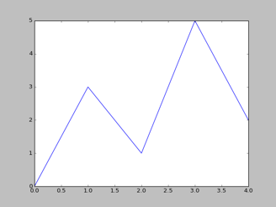
Plotting a Line Graph With the plot Function (1 of 4)
Use the plot function to create a line graph that connects a series of points with straight lines.
The line graph has a horizontal X axis, and a vertical Y axis.
Each point in the graph is located at a (X,Y) coordinate.
Notes:
The horizontal axis is labeled, this is the x axis, and the vertical axis is labeled, this is the y axis. The x axis ranges from 0.0 to 4.0, in increments of 0.5, and the y axis ranges from 0 to 5, in unit increments. The graph is a line that passes through the following points. (0.0, 0), (1.0, 3), (2.0, 1), (3.0, 5), and (4.0, 2). All values are estimated.

Slide 46
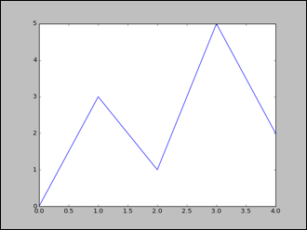
Plotting a Line Graph With the plot Function (2 of 4)
Program 7-20 (line_graph1.py)
1 # This program displays a simple line graph.
2 import matplotlib.pyplot as plt
3
4 def main():
5 # Create lists with the X and Y coordinates of each data point.
6 x_coords = [0, 1, 2, 3, 4]
7 y_coords = [0, 3, 1, 5, 2]
8
9 # Build the line graph.
10 plt.plot(x_coords, y_coords)
11
12 # Display the line graph.
13 plt.show()
14
15 # Call the main function.
16 if _ _name_ _ == '_ _main_ _':
17 main()
Notes:
The horizontal axis is labeled, this is the x axis, and the vertical axis is labeled, this is the y axis. The x axis ranges from 0.0 to 4.0, in increments of 0.5, and the y axis ranges from 0 to 5, in unit increments. The graph is a line that passes through the following points. (0.0, 0), (1.0, 3), (2.0, 1), (3.0, 5), and (4.0, 2). All values are estimated.

Slide 47
Plotting a Line Graph With the plot Function (3 of 4)
You can change the lower and upper limits of the X and Y axes by calling the xlim and ylim functions. Example:
plt.xlim(xmin=1, xmax=100)
plt.ylim(ymin=10, ymax=50)
This code does the following:
Causes the X axis to begin at 1 and end at 100
Causes the Y axis to begin at 10 and end at 50

Slide 48
Plotting a Line Graph With the plot Function (4 of 4)
You can customize each tick mark's label with the xticks and yticks functions.
These functions each take two lists as arguments.
The first argument is a list of tick mark locations
The second argument is a list of labels to display at the specified locations.
plt.xticks([0, 1, 2, 3, 4],
['2016', '2017', '2018', '2019', '2020'])
plt.yticks([0, 1, 2, 3, 4, 5],
['$0m', '$1m', '$2m', '$3m', '$4m', '$5m'])

Slide 49
Program 7-24 (1 of 2)
1 # This program displays a simple line graph. 2 import matplotlib.pyplot as plt 3 4 def main(): 5 # Create lists with the X,Y coordinates of each data point. 6 x_coords = [0, 1, 2, 3, 4] 7 y_coords = [0, 3, 1, 5, 2] 8 9 # Build the line graph. 10 plt.plot(x_coords, y_coords, marker='o') 11 12 # Add a title. 13 plt.title('Sales by Year') 14 15 # Add labels to the axes. 16 plt.xlabel('Year') 17 plt.ylabel('Sales') 18

Slide 50
Program 7-24 (2 of 2)
19 # Customize the tick marks. 20 plt.xticks([0, 1, 2, 3, 4], 21 ['2016', '2017', '2018', '2019', '2020']) 22 plt.yticks([0, 1, 2, 3, 4, 5], 23 ['$0m', '$1m', '$2m', '$3m', '$4m', '$5m']) 24 25 # Add a grid. 26 plt.grid(True) 27 28 # Display the line graph. 29 plt.show() 30 31 # Call the main function.
32 if __name__ == '__main__': 33 main()

Slide 51
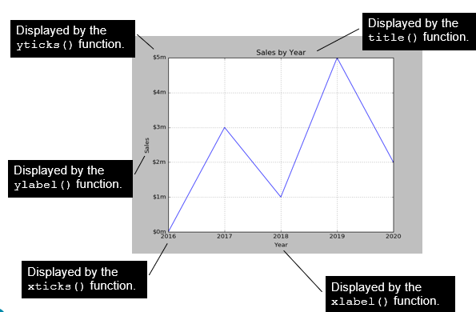
Output of Program 7-24
Notes:
The title of the graph is displayed by the title left parenthesis right parenthesis function. The horizontal axis is labeled year and ranges from 20 16 to 20 20, in unit increments. The values on the x axis are displayed by the x ticks left parenthesis right parenthesis function. The label on the x axis, year, is displayed by the x label left parenthesis right parenthesis function. The vertical axis is labeled sales and ranges from 0 million dollars to 5 million dollars, in increments of 1 million. The values along the y axis are displayed by the y ticks left parenthesis right parenthesis function. The y axis is labeled using the y label left parenthesis right parenthesis function. Grid lines are drawn from each of the x and y intercepts. The graph is a line that passes through the following points. (20 16, 0 million dollars), (20 17, 3 million dollars), (20 18, 1 million dollar), (20 19, 5 million dollars), and (20 20, 2 million dollars). All the points are plotted. All values are estimated.

Slide 52
Plotting a Bar Chart (1 of 6)
Use the bar function in the matplotlib.pyplot module to create a bar chart.
The function needs two lists: one with the X coordinates of each bar's left edge, and another with the heights of each bar, along the Y axis.

Slide 53
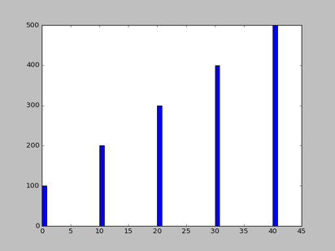
Plotting a Bar Chart (2 of 6)
left_edges = [0, 10, 20, 30, 40]
heights = [100, 200, 300, 400, 500]
plt.bar(left_edges, heights)
plt.show()
Notes:
The horizontal axis ranges from 0 to 45, in increments of 5, and the vertical axis ranges from 0 to 500, in increments of 100. The bars range up to the following values. (0, 100), (10, 200), (20, 300), (30, 400), and (40, 500). All values are estimated.

Slide 54
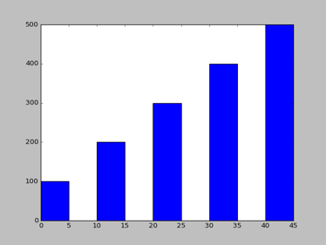
Plotting a Bar Chart (3 of 6)
The default width of each bar in a bar graph is 0.8 along the X axis.
You can change the bar width by passing a third argument to the bar function.
left_edges = [0, 10, 20, 30, 40]
heights = [100, 200, 300, 400, 500]
bar_width = 5
plt.bar(left_edges, heights, bar_width)
plt.show()
Notes:
The horizontal axis ranges from 0 to 45, in increments of 5, and the vertical axis ranges from 0 to 500, in increments of 100. The bars range up to the following values as tabulated below. The columns have the following headings from left to right. Horizontal axis values, Vertical axis values. The row entries are as follows. Row 1. 0 to 5, 100. Row 2. 10 to 15, 200. Row 3. 20 to 25, 300. Row 4. 30 to 35, 400. Row 5. 40 to 45, 500. All values are estimated.

Slide 55
Plotting a Bar Chart (4 of 6)
The bar function has a color parameter that you can use to change the colors of the bars.
The argument that you pass into this parameter is a tuple containing a series of color codes.
Color Code | Corresponding Color
'b' | Blue
'g' | Green
'r' | Red
'c' | Cyan
'm' | Magenta
'y' | Yellow
'k' | Black
'w' | White

Slide 56
Plotting a Bar Chart (5 of 6)
Example of how to pass a tuple of color codes as a keyword argument:
plt.bar(left_edges, heights, color=('r', 'g', 'b', 'w', 'k'))
The colors of the bars in the resulting bar chart will be as follows:
The first bar will be red.
The second bar will be green.
The third bar will be blue.
The fourth bar will be white.
The fifth bar will be black.

Slide 57
Plotting a Bar Chart (6 of 6)
Use the xlabel and ylabel functions to add labels to the X and Y axes.
Use the xticks function to display custom tick mark labels along the X axis
Use the yticks function to display custom tick mark labels along the Y axis.

Slide 58
Plotting a Pie Chart (1 of 5)
You use the pie function in the matplotlib.pyplot module to create a pie chart.
When you call the pie function, you pass a list of values as an argument.
The sum of the values will be used as the value of the whole.
Each element in the list will become a slice in the pie chart.
The size of a slice represents that element's value as a percentage of the whole.

Slide 59
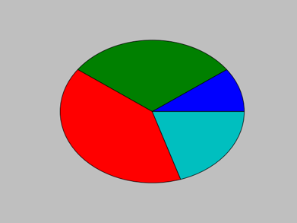
Plotting a Pie Chart (2 of 5)
Example
values = [20, 60, 80, 40]
plt.pie(values)
plt.show()

Slide 60
Plotting a Pie Chart (3 of 5)
The pie function has a labels parameter that you can use to display labels for the slices in the pie chart.
The argument that you pass into this parameter is a list containing the desired labels, as strings.

Slide 61
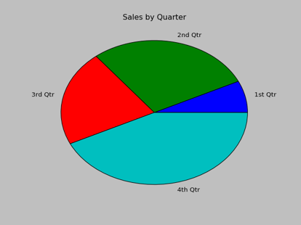
Plotting a Pie Chart (4 of 5)
Example
sales = [100, 400, 300, 600]
slice_labels = ['1st Qtr', '2nd Qtr', '3rd Qtr', '4th Qtr']
plt.pie(sales, labels=slice_labels)
plt.title('Sales by Quarter')
plt.show()
Notes:
The quarters are labeled, first quarter, second quarter, third quarter, and fourth quarter, respectively, counter clockwise. The first quarter is the smallest, followed by the third, second, and fourth quarters.

Slide 62
Plotting a Pie Chart (5 of 5)
The pie function automatically changes the color of the slices, in the following order:
blue, green, red, cyan, magenta, yellow, black, and white.
You can specify a different set of colors, however, by passing a tuple of color codes as an argument to the pie function's colors parameter:
plt.pie(values, colors=('r', 'g', 'b', 'w', 'k'))
When this statement executes, the colors of the slices in the resulting pie chart will be red, green, blue, white, and black.

Slide 63
Summary
This chapter covered:
Lists, including:
Repetition and concatenation operators
Indexing
Techniques for processing lists
Slicing and copying lists
List methods and built-in functions for lists
Two-dimensional lists
Tuples, including:
Immutability
Difference from and advantages over lists
Plotting charts and graphs with the matplotlib Package

Slide 64

Copyright
This work is protected by United States copyright laws and is provided solely for the use of instructors in teaching their courses and assessing student learning. Dissemination or sale of any part of this work (including on the World Wide Web) will destroy the integrity of the work and is not permitted. The work and materials from it should never be made available to students except by instructors using the accompanying text in their classes. All recipients of this work are expected to abide by these restrictions and to honor the intended pedagogical purposes and the needs of other instructors who rely on these materials.

